Slide 1

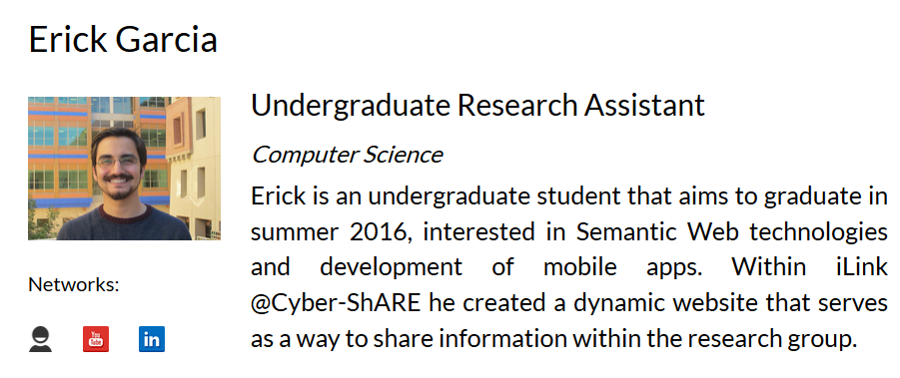
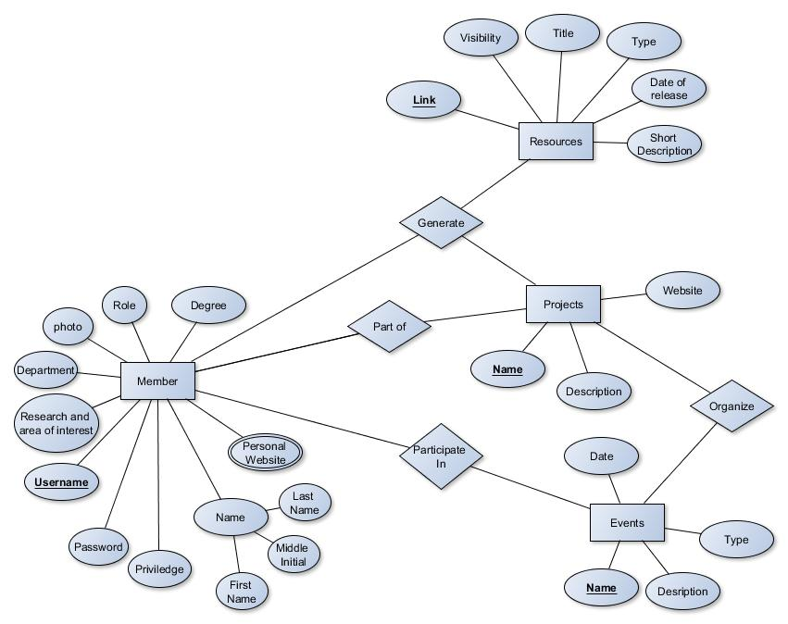

Semantic-based data integration and exchange for a research group
Erick Garcia^{1,2}, Supervised by: Dr. Natalia Villanueva Rosales^{1,2}
¹Department of Computer Science, ²Cyber-ShARE Center of Excellence
egarcia87@miners.utep.edu, nvillanuevarosales@utep.edu
The University of Texas at El Paso
Motivation
Background
Maintaining information about research group efforts is a tedious manual task.
Sharing resources using natural languages, like English, are good for humans but hard for computers to process. Sharing resources using machine languages, like JSON, are great for machines but hard for humans to understand (Fig. 1).
Having a one stop place where resources of research groups can be dynamically populated from other sources and share information for both, humans and machines, would save time and also increase reusability of their resources.
The Semantic Web is a standard promoted by the World Wide Web Consortium which aims at converting the World Wide Web from the current model largely unstructured documents and data into a common machine understandable framework that allows data to be shared and reused. [2]
Web-Services are client and server applications that enable the communication between two electronic devices over a network. [2]
Metadata is structured information that describes, explains, locates, or otherwise makes it easier to retrieve, use, or manage an information resource. Metadata is often called data about data. It is really important because it facilitates discovery of relevant information. [1]
Research Question
Methodology
Can semantic-, web-based approaches, e.g., ontologies, enable the creation of systems that automatically integrate information about a research group and share information for both humans and machines?
Design of a high-level data model (E/R diagram) that covers information retrieved from other sources and metadata (Fig. 2).
Evaluation for frameworks for web development that support s the creation of responsive mobile-, human-friendly website and the use of standards for interoperability
Develop the front- and back- end of a research group website through the use latest web-based technologies.
Comparing metadata standards and vocabulary to share research group’s resources with semantic annotations.
Annotate semantically the information shared through the website.
Evaluate the web-based system.
Objective
Design a web-based application for the iLink research group that can be :
dynamically populated from heterogeneous sources,
mobile-friendly for human consumption,
use web standards for interoperability of other systems, and
share resources using semantic annotations (meta-data) for machine processing.
Person
Position
Results
The iLink research group’s dynamic website was created. This website is: i) dynamically populated from other sources, ii) based on Model-View-Controller architecture, iii) based on standard web-languages and technologies including Bootstrap, Code Igniter, HTML5 and JSON.
The information shared on the iLink’s website is prepared for semantic annotations to be fully understandable for both humans and machines. We are currently identifying controlled vocabularies to describe the information on the website, including Friend of a Friend[3] and schema.org
Degree
Research Interests
Personal Website
Figure 1. Differences between data that can be understood by humans vs. data that can be understood by machines.
Future Work
Evaluation of the system based on:
Discoverability of resources by machines using metadata.
Usability for human users.
References
[1] Understanding Metadata (pp. 4-10). (2004). Bethesda, NISO Press National Information Standards Organization
[2] Semantic Web, Retrieved April 15, 2015 from http://www.w3.org/standards/semanticweb/data
[3] FOAF, Retrieved April 15, 2015 from http://www.foaf-project.org/.
[4] iLink Website: http://iLink.cybershare.utep.edu/
Figure 2. Entity Relationship diagram representing iLink’s information
Supported in part by the National Science Foundation under CREST Grant No. HRD-0734825 and HRD-1242122.
Any opinions, findings, and conclusions or recommendations expressed in this material are those of the authors and do not necessarily reflect the views of the National Science Foundation (NSF).
Supported in part by the National Science Foundation under CREST Grant No. HRD-1242122 and DUE-0963648.
Any opinions, findings, and conclusions or recommendations expressed in this material are those of the authors and do not necessarily reflect the views of the National Science Foundation.
Notes:
1

